Slide 1
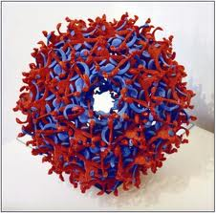
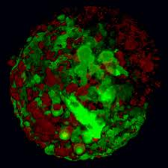
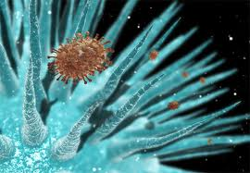
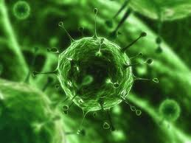
  Infectious Diseases
  Lesson 4.4

Slide 2
Lesson Objectives:
After finishing today’s lesson, you will be able to:
explain how viral replication leads to host cell lysis.
describe the replication of DNA and RNA viruses.
explain why RNA viruses carry special enzymes to copy RNA.

Slide 3
Do Now
How do viruses cause damage and make us sick?
  Direct damage
  Indirect damage
  They cause host cell lysis.

Slide 4
Discussion
The viral lifecycle has FOUR stages. Do you remember them from Unit 1?
  The virus attaches and enters the host cell.
  The virus hijacks the host cell so it can replicate.
  The new viruses exit the host cell.
  ‘How’ a virus exits depends on whether the virus is naked or enveloped.

Slide 5
Step ONE: Viral Entry
Can you remember the entry strategies for:
  Naked viruses?
  Enveloped viruses?

Slide 6
How NAKED viruses enter host cells
The naked virus might inject their genome through the host cell membrane: for example, viruses that infect bacteria (bacteriophages).
The naked virus might be taken
up by endocytosis and
then punch holes in the endosome
membrane: for example, polio virus.
Cell membrane
Nucleus
Capsid & Genome
Once the genome is in the cell
it can begin to replicate.

Slide 7
How ENVELOPED viruses enter host cells
Cell membrane
Because the enveloped virus also
has a membrane it might fuse
with the host cell membrane:
e.g., HIV
The enveloped virus might be taken
up by endocytosis and then fuse
with the endosome membrane:
e.g., H1N1
Nucleus
Once the genome is in the cell
it can begin to replicate.

Slide 8
Step TWO: Viral Replication

Slide 9
The viral genome determines the structures of the host cell used during replication
RNA viruses (their genome is RNA molecule)
DNA viruses (their genome is DNA molecule)

Slide 10
Before we can learn how viruses replicate we need to review molecular dogma!
DNA
RNA
Protein
Replication
Transcription
Translation

Slide 11
Where in the eukaryotic cell do these processes take place?
Cell membrane
Replication
DNA
Nucleus
Transcription
RNA
Translation
Protein
Cytoplasm

Slide 12
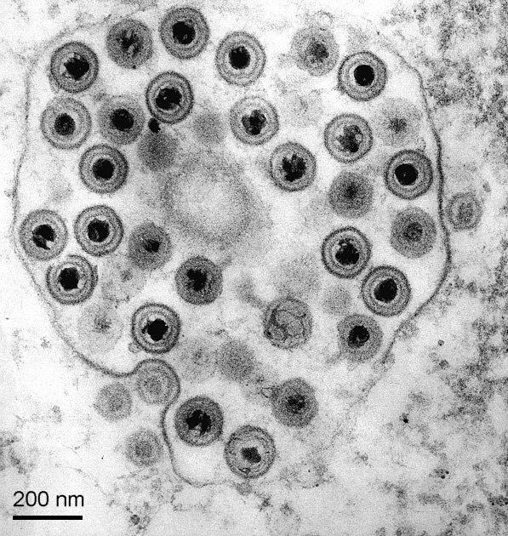
DNA viruses follow molecular dogma
DNA ➔ RNA ➔ PROTEIN
They need to get their DNA into the nucleus
Herpesvirus in a
Host cell
Herpesvirus is a DNA virus

Slide 13
DNA viruses need host proteins to replicate
DNA ➔ RNA ➔ PROTEIN
Herpesvirus is a DNA virus

Slide 14
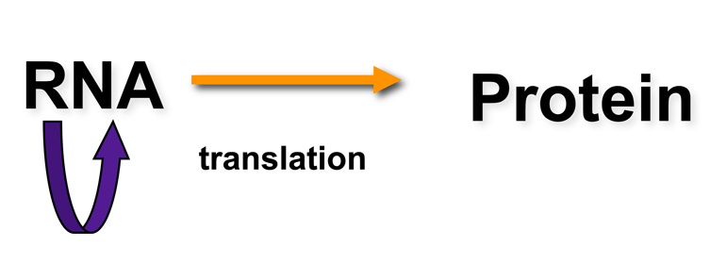
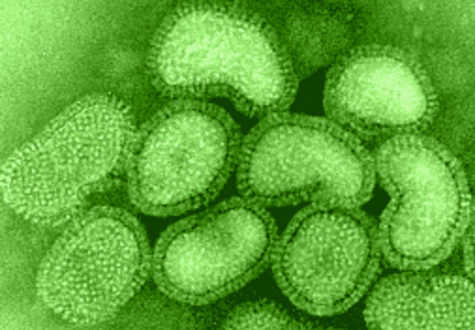
RNA viruses defy molecular dogma by making RNA from RNA!
RNA ➔ RNA ➔ PROTEIN
RNA-dependent
RNA polymerase
H1N1
To do this they bring specialized
enzymes with them.

Slide 15
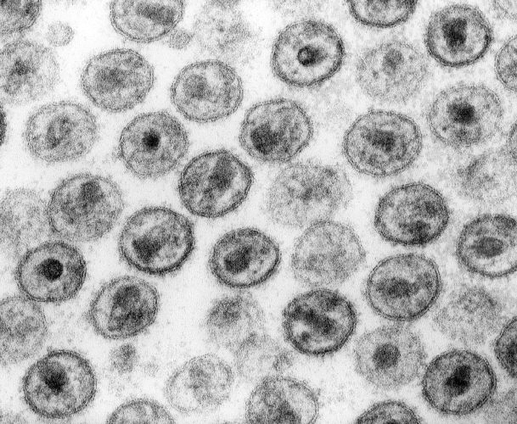
RNA viruses defy molecular dogma by making DNA from RNA!
RNA ➔ DNA ➔ RNA ➔ PROTEIN
Retroviruses such as HIV are
RNA viruses
2. They make DNA from RNA

Slide 16
To defy molecular dogma, retroviruses
bring specialized enzymes with them
Reverse
transcriptase
RNA ➔ DNA ➔ RNA ➔ PROTEIN
Integrase
Host DNA
Retroviruses bring the reverse transcriptase enzyme with them.
They use an integrase, to insert the DNA into the host genome.

Slide 17
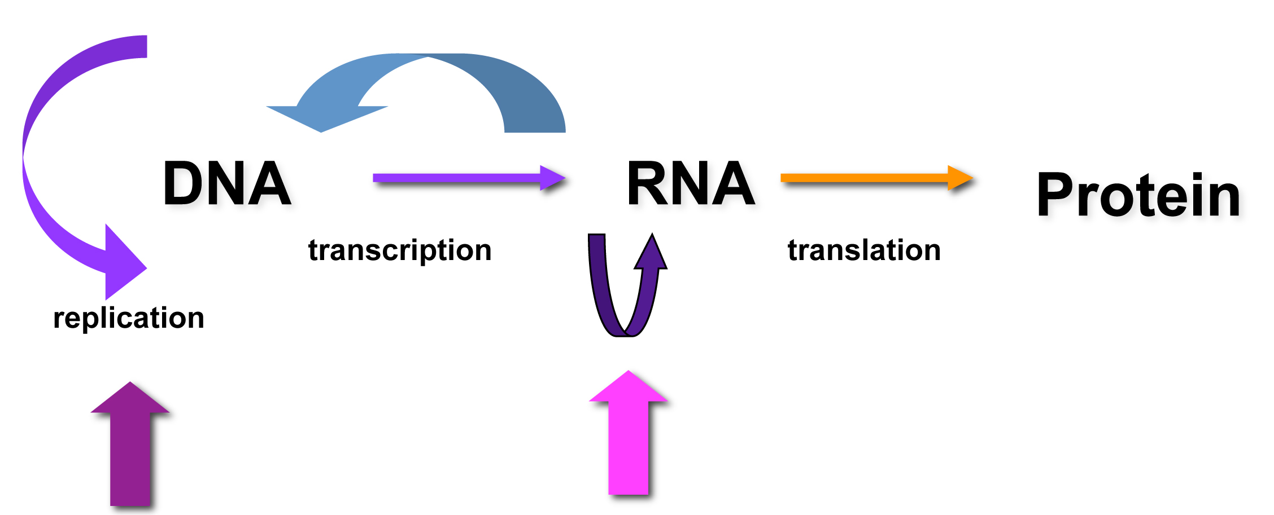
RNA viruses cannot correct errors
No RNA repair,
No proofreading (1 error in 100,000 bases)
DNA repair,
Proofreading (1 error in 100,000,000 bases)
Random uncorrected mutations in RNA viruses cause Antigenic Drift (will cover in lesson 4.5)

Slide 18
Step THREE: Viral Exit
Can you remember the exit strategies for:
  Naked viruses?
  Enveloped viruses?

Slide 19
How NAKED viruses exit host cells
The host cell fills with mature viruses and bursts.
This is called lysis.
Mature viruses
Even bacteria can be infected by viruses!
This is a naked virus, called a bacteriophage, that infects bacteria.

Slide 20
How ENVELOPED viruses exit host cells
The new envelope proteins are collected in the host cell membrane.
The new capsid proteins and the genome collect below the envelope proteins.
The new enveloped virus forms and buds off from the host cell.
The new virus buds off the membrane
The capsid pushes out and picks up envelope

Slide 21
Wrap Up
Compare and contrast
 | Naked | Enveloped
Entry
Exit
 | Naked | Enveloped
Entry | Injection Endocytosis | Fusion Endocytosis then fusion
Exit | Host cell lysis | Budding

Slide 22
Wrap Up
Compare and contrast
 | DNA viruses | RNA viruses
Location of genome replication
Enzymes used to replicate the genome
Mutation rate of polymerase
Enzymes used to integrate their genomes
 | DNA viruses | RNA viruses
Location of genome replication | Nucleus | Cytoplasm
Enzymes used to replicate the genome | Host DNA polymerase | Viral RNA dependent RNA polymerase Viral Reverse Transcriptase
Mutation rate of polymerase | Low | High
Enzymes used to integrate their genomes | Usually none | Viral Integrase

Slide 23
Homework
Complete the tables in your worksheet and review your notes.

